Slide 1
Fundraising 101 Introduction to Fundraising
Lucy Stone (She/Her)
No Stone Unturned Fundraising

Slide 2
Lucy Stone - about me!
Increase Grant, Trust and Foundation income
Develop new income streams
Improve relationships with funders
Arts & Cultural organisations
Sussex Grassroots Organisations

Slide 3
Who I've worked with

Slide 4
Session overview
What are the different fundraising options open to you?
How do you know which options are right for your organisation?
What are the practical first steps you can take to diversify
your income?
How can you support everyone in the organisation to help with fundraising?
What else might you need to think about?

Slide 5
1. What are the different fundraising options open to you?

Slide 6
Why look at different options?
Security in different income streams.
Financial resilience.
Untapped potential.
Develop new relationships.
Do more of your amazing work!

Slide 7
What are the options?
Top line data
Size of the different income streams.
Main income streams for charities and not for profits.
Risk.
Return on investment (ROI).
Cultivation timelines.
Length of relationship.

Slide 8
Context is key!
All of this data must be understood within the context of:
Charities report in different ways.
97% of charities have an income of under £1 million.
ROI data is becoming more thin on the ground.
Some charities have vastly different ROIs but this does not always take into account longer term investment.

Slide 9
 | Time to get a result | Length of relationship | Pot size | ROI
Grants, Trusts & Foundations | 6-9 months | 1-3 years | £6.5 billion | 10:1
National Lottery | 6-9 months | 1-5 years | £1.65 billion | 10:1
Corporations | 2 years | 3 years | £362 million | 5:1
Relationship Fundraising
Individual Giving / Supporters | 1.5 years | Ongoing | £10.3 billion | 10:1
Major Donors | 2.5 years | Ongoing | £3.2 billion | 6:1
Legacy | 4.4 years | Ongoing | £2.8 billion | 35:1
Events | 3-5 years | Ongoing | £135.5 million | 2:1

Slide 10
Trusts, Foundations & Lottery
Trusts & Foundations = £6.5 billion donated
Wellcome Trust gave out £349 million
The top 10 give out over £1 billion
£2.9 billion from the top 300 trusts
Tens of thousands of Trusts & Foundations
National Lottery = £1.65 billion

Slide 11
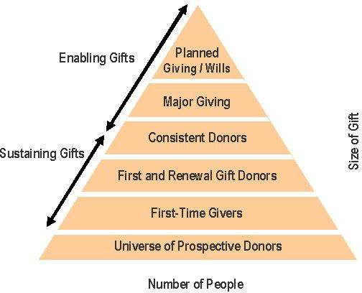
Individual Giving Pyramid

Slide 12
What are the other options?
Government spending = £15.3 billion/ year including grants, fees and contracts, government endowments for grant-makers, and annual
grant-in-aid awarded to "a r m’ s length bodies" (ALBs)
Earned income - data varies
Social Investment Funds - data varies

Slide 13
2. How do you know which options are right for your organisation?

Slide 14
Invest & Plan - luck won't work
What is clear is that charities who invest and plan for the long term get the results.
"Ice bucket challenge" or "Captain Sir Thomas Moore" phenomenon fundraising transformations are rare.

Slide 15
Income Bingo!
Monthly Donations | Legacy | Membership schemes | Crowdfunding
Merchandise | Major Donors | Online | Trusts & Foundations
Live Streaming | Ebay | Events (virtual & challenge) | Retail
Charity Ball | Street Fundraising | Door to door | Corporates

Slide 16
BINGO!

Slide 17
It’s n ot bingo!
You need to find the mix that works best for you.

Slide 18
“Start with people. Your existing supporters and potential supporters. Then decide, from the myriad of possibilities, how best to reach them. But don’t structure your fundraising plan by starting with a list of types/disciplines of fundraising.
You are you. You are unique. You are addressing a specific need. People and organisations will want to engage with you, and support you.
Start there."
"How many different types of fundraising are there?" Giles Pegram CBE, 3 January 2019 here

Slide 19
3. What are the practical first steps you can take to diversify your income?

Slide 20
Why would someone support you?
Social Benefit
What you deliver / activities
Who you work with
Cultural and Economic Value
Your Audiences
Connection to the Cause
Personal values
Faith and Religion
Social Proof

Slide 21
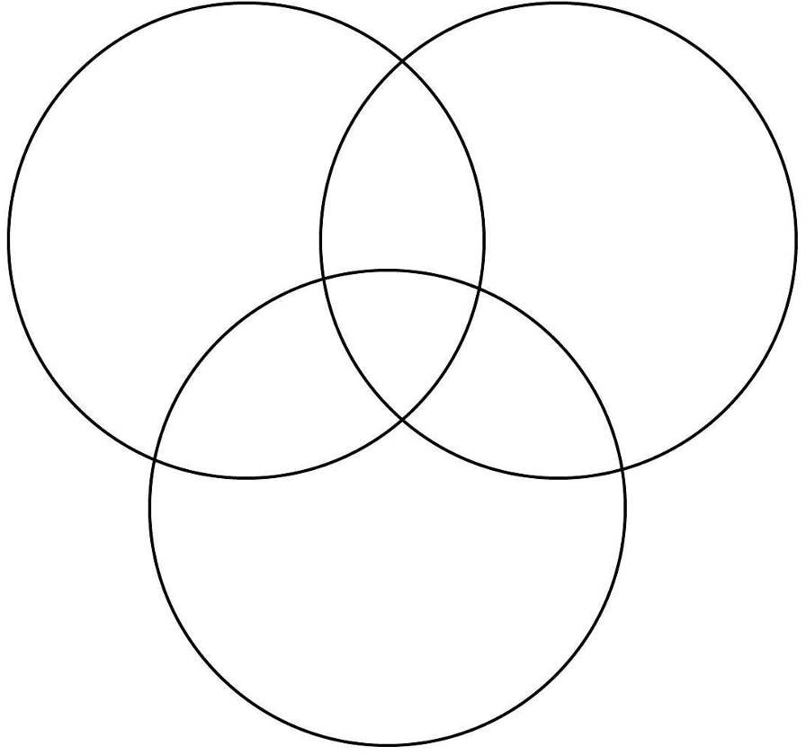
Finding the right supporters
Affinity
Propensity
Capacity

Slide 22
Affinity: Link to your cause
Do they have a connection to your work?
Emotional, social or political connections.
Do you have an affinity to your mission?
We all have preferences - no cause is for every supporter.
Find the connection!

Slide 23
Propensity: Inclination to give
Do they already give to you or similar causes?
How to do they give - membership schemes, regular donations, big gifts, percentage sales, events?
How do they approach giving - loud and proud or under the radar?

Slide 24
Capacity: Ability to give
How much might they be able to give?
What kind of gift could they make - cash, time, assets, connections?
Are they able to give personally, through a company or a charitable trust?

Slide 25
Who are these people?

Slide 26
We can wear many hats
For example an individual may support charities as
trustee of a grant giving not-for-profit
staff member of a business with a "charity of the year"
challenge event fundraiser
volunteer
regular donor
in memory in will

Slide 27
Who - Network mapping
Network of people you have around you or want to have around you.
Who do you know?
Who do they know?
Who do you want to get to know?

Slide 28
Network mapping - current
Who already supports you?
Who is in your network? Networks of Staff, Trustees, Organisations.
Who are your stakeholders?
What are your connections?

Slide 29
BUT!
Are you managing those relationships well?
Be honest!

Slide 30
Network mapping - new
Are your current supporters able to introduce you to others?
Where can you make new connections?
Who do you want to reach?
Who else might be interested in what you do?

Slide 31
4. How can you support everyone in the organisation to help with fundraising?

Slide 33
People give to people - fundraising is about relationships.
Your team will be amazing at developing relationships & partnerships!
We need to make it less scary when it’s linked to fundraising!

Slide 34
Making fundraising less scary!
Talking about money is hard - how can you start to have conversations in your organisation about fundraising?
Trustees - do you have expertise on your board?
Network mapping - how can they be part of that?
Do they feel comfortable talking about your work? Do you need time to practice the 8elevator pitch9?
What would your team feel comfortable doing?

Slide 35
5. What else might you need to think about?

Slide 36
Things to think about
Ethical policy - how do you make decisions about who will you accept support from.
Tax efficient giving (e.g. a £10k donation from a 40% tax rate payer only costs them £7.5k).
Stewardship & Donor Journey - have you mapped your touchpoints and interactions?

Slide 37
Board and trustees
Is your board on board with fundraising?
Will they understand how to support you doing this work?
How are they making decisions about investment in fundraising?
Do you have someone with fundraising experience on your board?
Do you have a sub group or development committee?

Slide 38
Gift Aid
Are you up to date with your Gift Aid claims?
Did you know you can claim for the last 4 years?
Have you claimed Gift Aid on Small Donations (GASDS)
25% on cash donations of £30 or less without the need for a Gift Aid declaration
buckets an collecting tins
£2,000 (on £8,000 of donations) per year
Is your statement up to date - can you claim for all previous and future donations?

Slide 39
Facebook groups
Fundraising Chat
Trust Fundraising Hub Sussex Fundraisers Group Fundraisers in Kent

Slide 40
Keep in touch
I will be producing free templates over the coming months so please email me
lucy@nostoneunturned.uk
@Lucy_Stone
www.nostoneunturned.uk
www.linkedin.com/in/lucy-stone-charity/

