Slide 1
Measuring Your Impact
Lucy Stone

Slide 2
Lucy Stone - about me!
Increase Grant, Trust and Foundation income
Develop new income streams
Improve relationships with funders
Arts & Cultural organisations
Sussex Grassroots Organisations

Slide 3
Who I've worked with

Slide 4
I am also a Trustee!

Slide 5
You
How are you?
How is your mental health?
Are you getting support?
Are you taking breaks?
How is your time management?
Are the 8nos9 hitting you harder?

Slide 6
You
You can not do your best work for your organisation if you are not ok.
You can9t write well if you are frazzled
This has always been an important question, however, with COVID-19 and cost of living crisis the world is different.

Slide 7
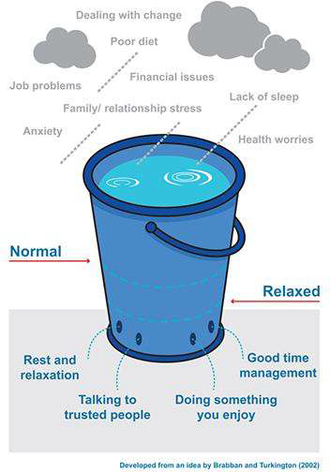
Stress Bucket

Slide 8
Session Overview
What talk about impact?
Outcomes are a piece of cake!
Inputs and Outputs
Writing outcomes
Evaluation systems
Evaluation Framework
Theory of Change
How can you use the data and stories collected?

Slide 9
Why talk about impact?
Telling stories about your work
Using evidence not anecdotes
Funders and donors want to know how their support will or has help
Evaluation, monitoring and reporting
Shows the change that you make happen in the world
Underpins your case for support

Slide 10
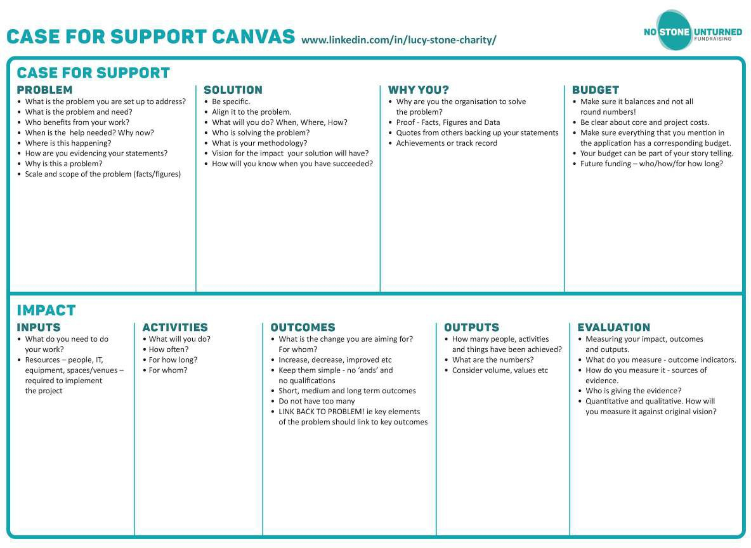

Slide 11
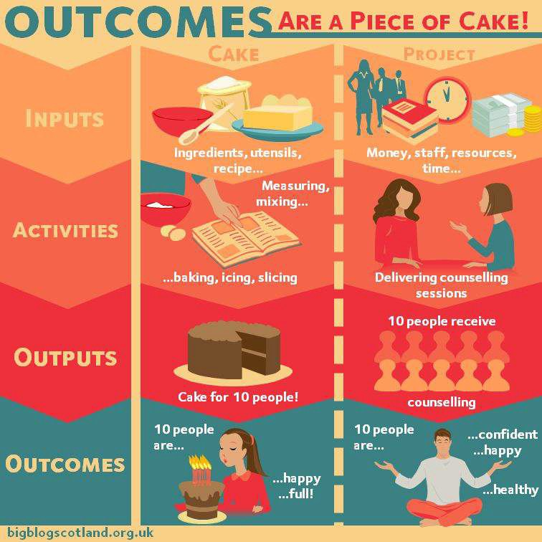
Outcomes
Funders want to understand your impact
Muddling up your input, activities, outputs and outcomes - think CAKE!
https://bigblogscotland.org.uk/2014/03/17/outcomes- are-a-piece-of-cake/
11

Slide 12
Inputs
Outputs
What do you need to do your work?
Budget items required to implement the project
Resources - IT, equipment, spaces/ venues
People and expertise
How many people, activities and 8things9 have been achieved?
What are the numbers?
Consider values, volume etc

Slide 13
How to write an outcome
A CHANGE that you expect to see
Increase / Improved / Decrease / Reduced
8Soft9 outcomes are as important as 8hard9 outcomes
Keep them simple - no 8and9, commas or qualifiers
Don9t have too many!
Can have a number output assigned to them.

Slide 14
Outcome planning
What do you want people to gain?
Think about
Knowledge and/or skills
Attitudes
Behaviours
NPC Theory of Change Link

Slide 15
Outcome examples
Increased confidence
Reduced isolation or increased positive relationships
Improved XYZ skills/ literacy/ maths
Increased self motivation
Decreased stress or increased wellbeing
Increased number of people supported

Slide 16
Evaluation Systems - what might be included?
Outcomes, Inputs, Outputs, Activites
Evaluation framework
Questionnaires - evaluation forms, sticker charts
Consultation frameworks - interviews, focus groups, debriefs etc
Social media data gathering
Theory of Change
Iterative project changes - it9s a cycle
●

Slide 17
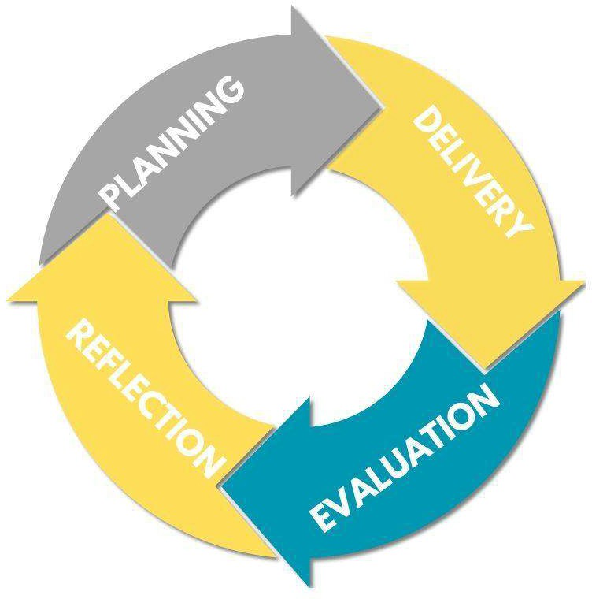
It’s a cycle

Slide 18
Evaluation Framework
Plan for
What your outcomes are
How you will measure your outcomes
What are you measures of success are
How you will collect the data - what are the sources of evidence
Who will give you feedback
Let9s look at an example..

Slide 19
Evaluation Framework
Outcome | Measure of Success/ Outcome Indicators | Source of Evidence | Result Examples
What is the outcome you are aiming for? | How will you know if it has been a success? | Where will you find that information? | What data will you have?
What change will you see? | Who is giving you this information? | What are the methods of evidence collection | Quantitative and Qualitative
Increase confidence
Reduce Isolation
Improve wellbeing

Slide 20
Outcome | Measure of Success/ Outcome Indicators | Source of Evidence | Result Examples
 | How will you know if it has been a success? | Where will you find that information? | What data will you have? Quantitative and Qualitative
Increase confidence | Report feeling more confident and enjoyment by Participants Key workers Parents/ carers Your team Level of/ Number of etc Other evidence of confidence | Evaluation forms (next slide) from Participants Key workers Parent/ carer Your team Session observations by team members/ professionals Anecdotal evidence e.g song lyrics, activities participated in. Qualitative feedback - quotes and case studies Focus groups | X% of participants feel more confident X% of participants would come again X% of key workers/ parents/ carers report observing increased confidence Quotes Case Studies Number of people attending the full course 20

Slide 21
Questionnaire example
 | 1 | 2 | 3 | 4 | 5
I feel more confident after the workshops (increase confidence)
I could contribute my ideas a the workshop (increase confidence)
I made friends at the workshops (reduce isolation)
I had fun at the workshops (improve wellbeing)
The workshops help me feel less worried (improve wellbeing)
I would recommend this to others (general feedback)
What three things have you learnt at the workshop 1. 2. 3.
What else would you like to tell us? 21

Slide 22
Evaluation Framework - Good practice
Keep the questions simple.
What data are you already collecting?
Try to have at least two indicators for each outcome.
Combine quantitative data (numbers) and qualitative data (descriptions or narrative).
How can you hear different voices and perspectives?
Think about the measures of success in a broad sense - in the example - what else might show increased confidence?

Slide 23
Theory of Change

Slide 24
What is a Theory of Change?
8A Theory of Change is a diagram that explains how a programme has an impact on its beneficiaries. It outlines all the things that a programme does for of its beneficiaries, the ultimate impact that it aims to have on them, and all the separate outcomes that lead or contribute to that impact.
A Theory of Change should not refer to the scale, growth plan or operational details of the organisation itself – it should effectively describe and explain the impact of the programme from a beneficiary9s point of view.”
NESTA

Slide 25
What is a Theory of Change?
Diagram
Explains impact
Impact on beneficiaries
From beneficiaries point of view
Can be for whole organisation or a project (or both!)
Examples...

Slide 26
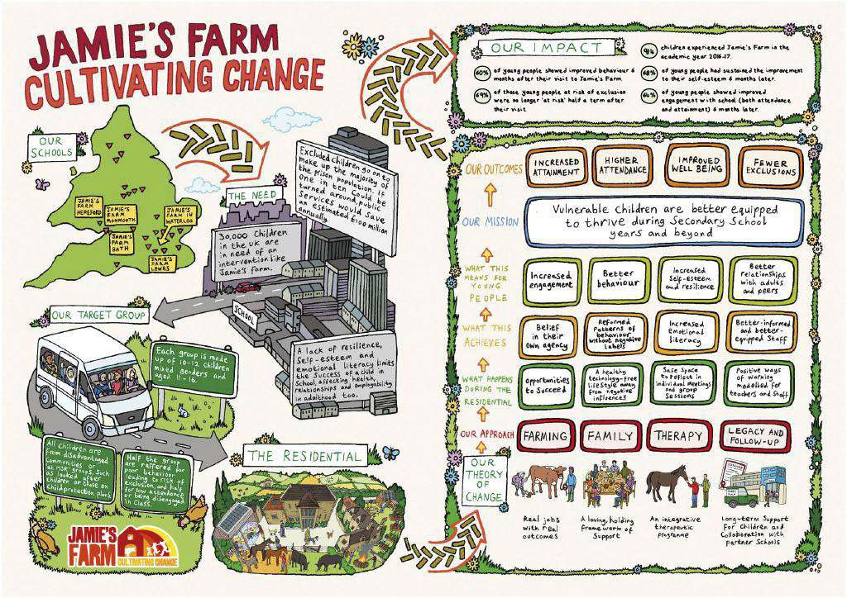

Slide 27
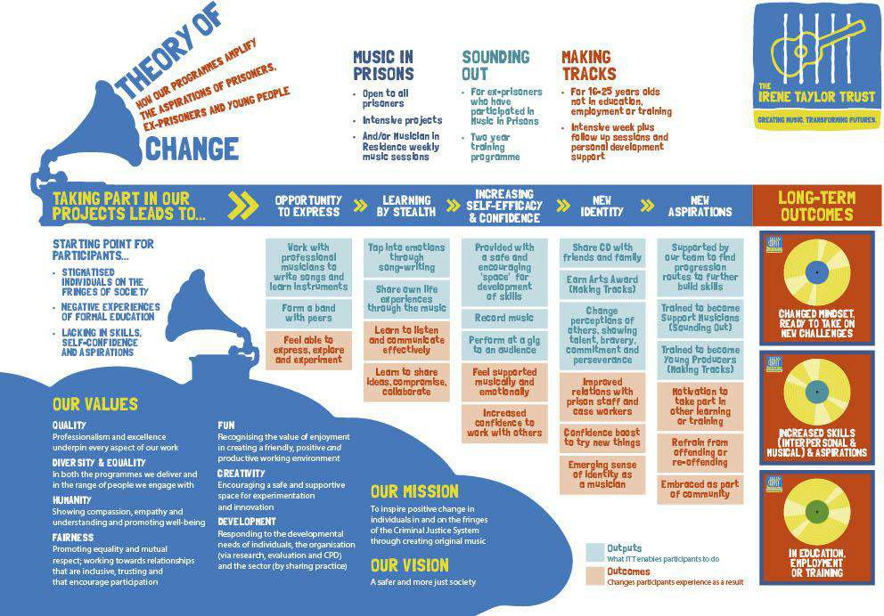

Slide 28
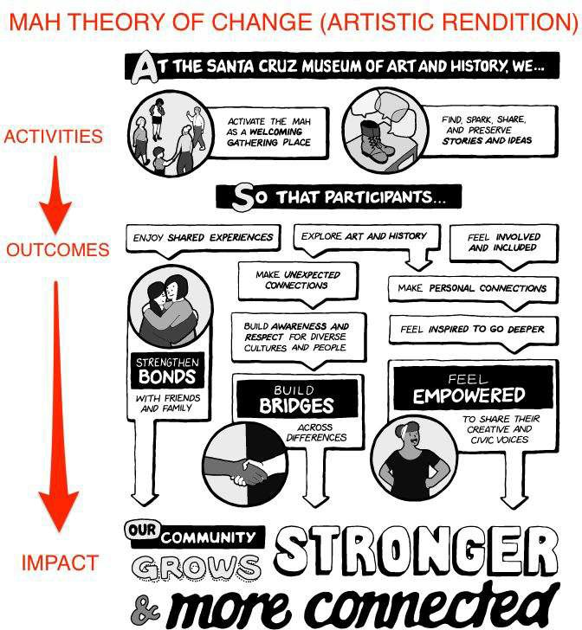

Slide 29
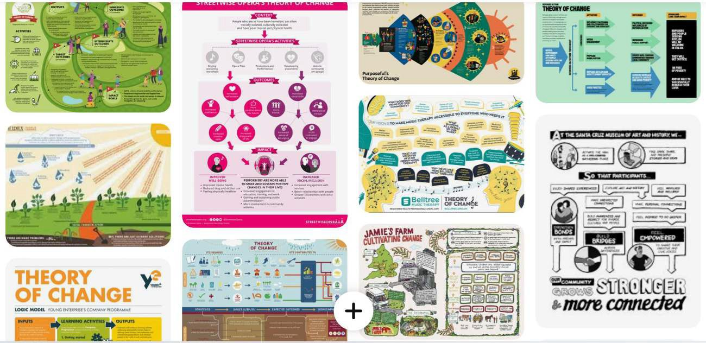
Theory of Change - more examples link

Slide 30
Why have a Theory of Change?
Simple way to communicate purpose and impact
Charity strategy in clear and simple format
Programme development
External communication - social media, specific campaigns
Evaluation

Slide 31
What is in a Theory of Change?
Ultimate Goal
Outcomes
Activities
Inputs and Outputs
Assumptions

Slide 32
How can you use the data and stories collected?
Case for Support: Solution and Why You?
Evaluation to funders
Social Media
Annual report/ Impact report
Building your Theory of Change - short, medium and long term
Planning new work and projects
Business plan

Slide 33
Resources
NCVO - Impact and Evaluation Resources link
NCVO - How to build a Theory of Change link
Think NPC - Creating Your Theory of Change link
Think NPC - Theory of Change in 10 Steps link
NESTA - Theory of Change link

Slide 34
Keep in touch
I will be producing free templates over the coming months so please email me
lucy@nostoneunturned.uk
@Lucy_Stone www.nostoneunturned.uk www.linkedin.com/in/lucy-stone-charity/

