Slide 1
How do you find the best Funders for you
Prospecting and Research
Lucy Stone, No Stone Unturned Fundraising

Slide 2
Lucy Stone - Helping not for profits
Increase Grant, Trust and Foundation income
Develop new income streams
Improve relationships with funders
Arts & Cultural organisations
Sussex Grassroots Organisations
2

Slide 3
Who I've worked with

Slide 4
I am also a Trustee!

Slide 5
Session overview
Charity Registers
FREE resources
Paid resources
Charity Commission Website
Charity Accounts
Database

Slide 6
You
How are you?
How is your mental health?
Are you getting support?
Are you taking breaks?
How is your time management?
Are the 8nos9 hitting you harder?

Slide 7
You
You can not do your best work for your organisation if you are not ok.
You can9t keep on track if you are feeling overwhelmed.
This has always been an important question, however, with COVID-19 the world is very different.

Slide 8
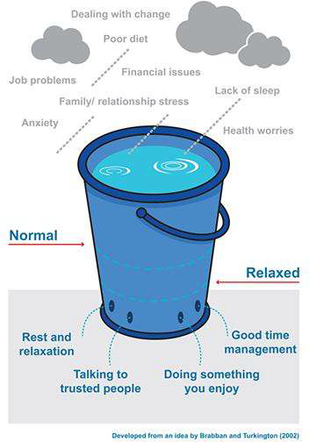
Stress Bucket

Slide 9
What are Trusts & Foundations?
Trust = specific legal entity. Most are charities but not always. Not all give grants!
Foundation = Trust, Charity, Ltd Company etc
Grants = can be given by Trust, Foundations, Government, companies etc.
Can be family, corporate, community etc

Slide 10
Trusts & Foundations (2019/20)
Trusts & Foundations = £6.5 billion donated
Wellcome Trust gave out £679 million
The top 10 give out over £1.4 billion
£3.48 billion from the top 300 trusts
Tens of thousands of Trusts & Foundations
National Lottery = £1.85 billion

Slide 11
Where can we find the information?

Slide 12
Charity Registers
Charity Commission England and Wales https://beta.charitycommission.gov.uk/charity-search/
Scottish Charity Regulator OSCR https://www.oscr.org.uk/
The Charity Commission for Northern Ireland https://www.charitycommissionni.org.uk/

Slide 13
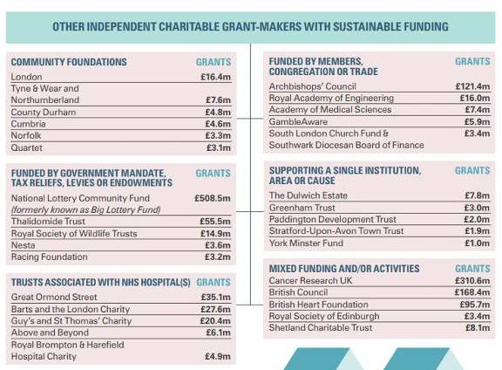
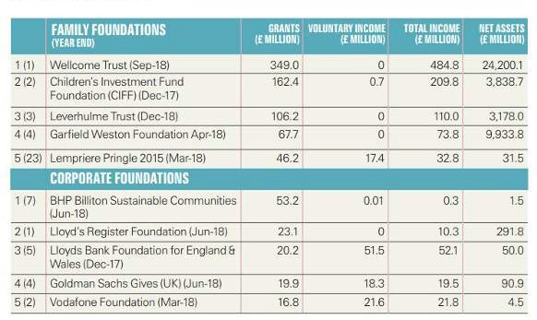
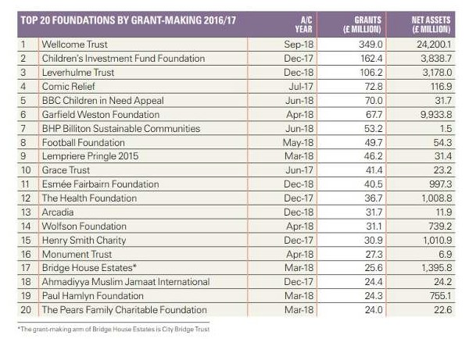
Free resources
ACF Foundation Giving Trends https://www.acf.org.uk
- annual publication reviewing top 300 grant makers

Slide 14
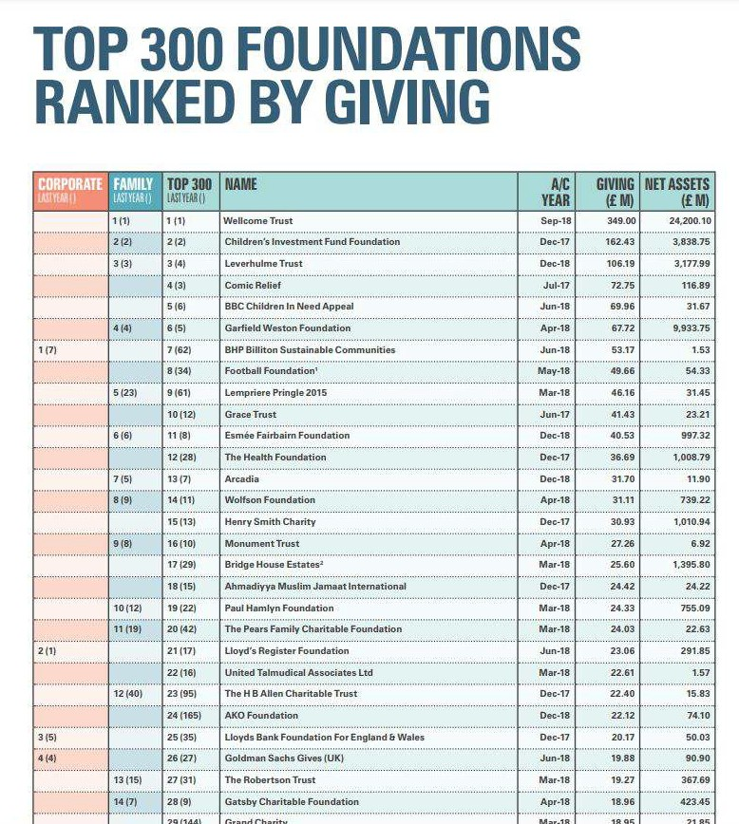

Slide 15
Free resources
Charity Excellence Framework FREE COVID Funder Database
https://www.charityexcellence.co.uk/
360 Degree Giving http://grantnav.threesixtygiving.org/
- grant giving data from 142 funders
Competitors websites and accounts

Slide 16
Free resources
Livery Companies Database http://liverydatabase.liverycompanies.info/
- 110 livery companies, comprising London's ancient and modern trade associations and guilds
101 Ways to Grow Your Prospect List - Alicia Granger https://www.aliciagrainger.co.uk/

Slide 17
Free resources - Facebook
Fundraising Chat
https://www.facebook.com/groups/FundraisingChat
Trust Fundraising Hub
https://www.facebook.com/groups/trustfundraisinghub

Slide 18
Free & Paid for resources
Directory of Social Change (DSC) https://www.dsc.org.uk
Printed Directories - available to buy or FREE in the library
Funds Online - https://fundsonline.org.uk/ (£410+VAT)
NCVO MY Funding Central
FREE for charities under £30k, Up to £50k is £50+VAT up to under
£1mill is £300+VAT https://www.myfundingcentral.co.uk/
£1mill + is GrantFinder www.grantfinder.co.uk/funding-services
Grants Online www.grantsonline.org.uk
Various Subscription options - FREE Newsletter

Slide 19
Charity Commission Website
Searchable: You can search the register of charities in England and Wales
Research: find out more about those you want to apply to

Slide 20
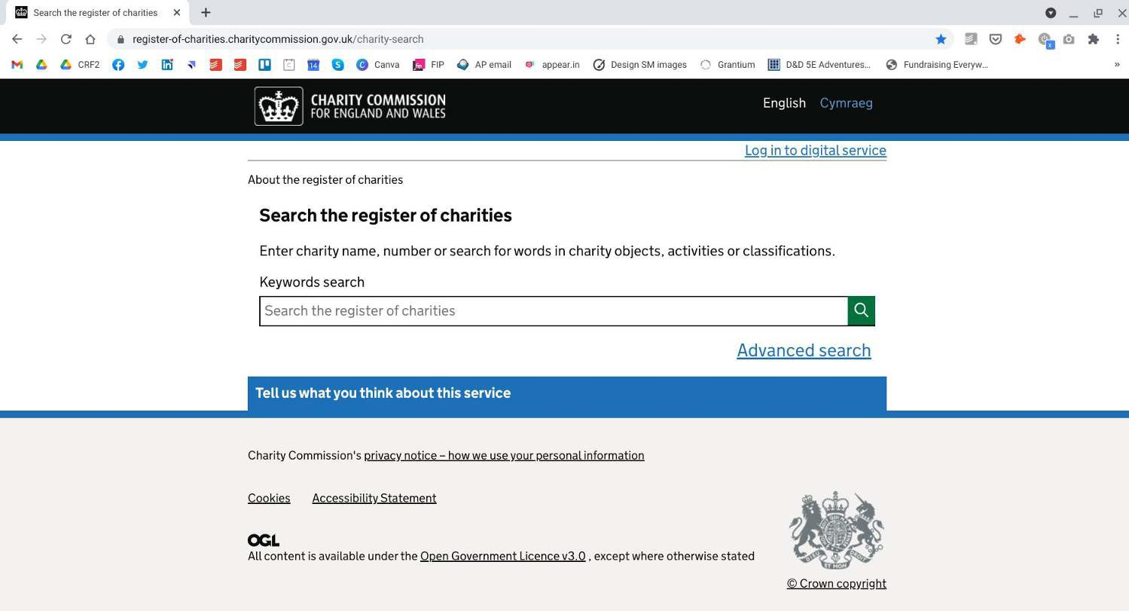
Charity Commission Website
Click search
https://register-of-charities.charitycommission.gov.uk/charity-search

Slide 21
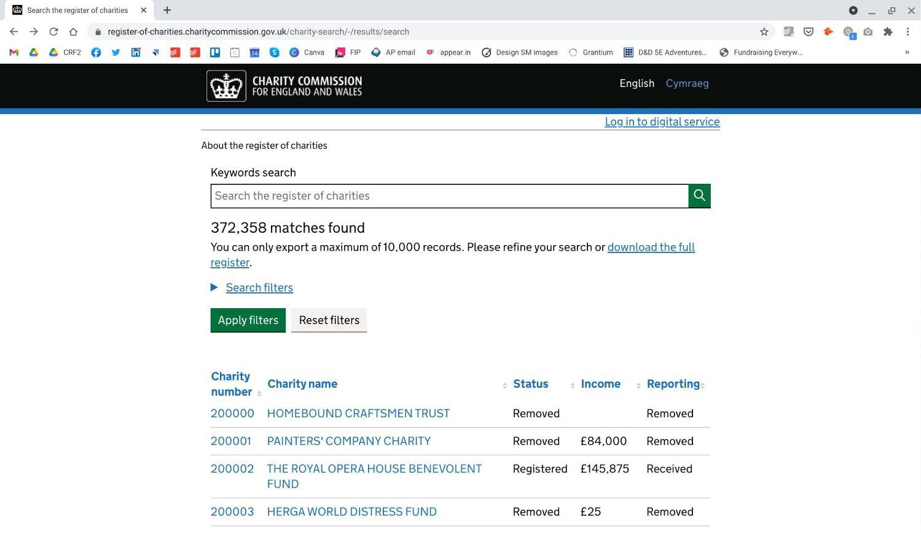
Charity Commission Website
Download when under 10,000
record

Slide 22
Charity Commission Website
Refined searches

Slide 23
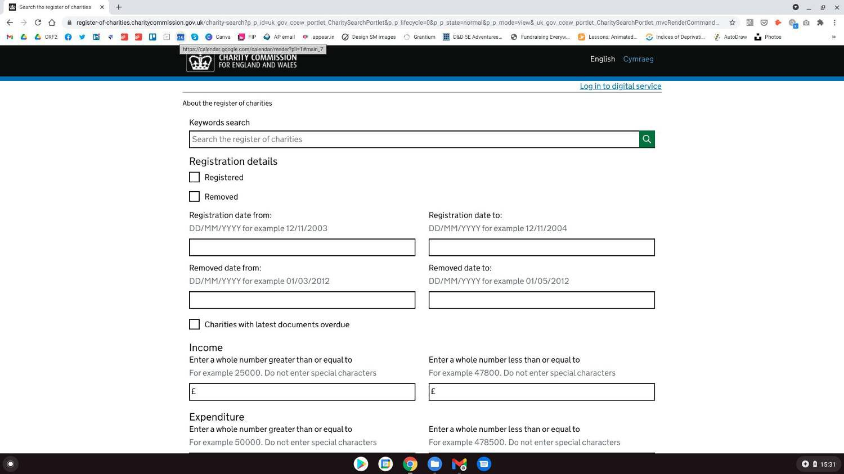
Look for newly registered charities

Slide 24
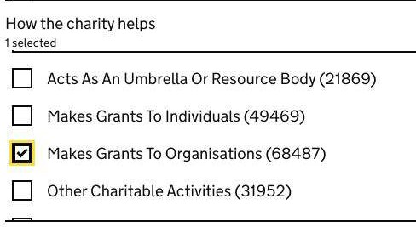
Search options
Classifications - Art, General Charity, Disability etc
Who the charity helps - Children, Older people, People with disabilities etc
How the charity helps - 8Makes Grants to
Organisations9
Geographical boxes

Slide 25
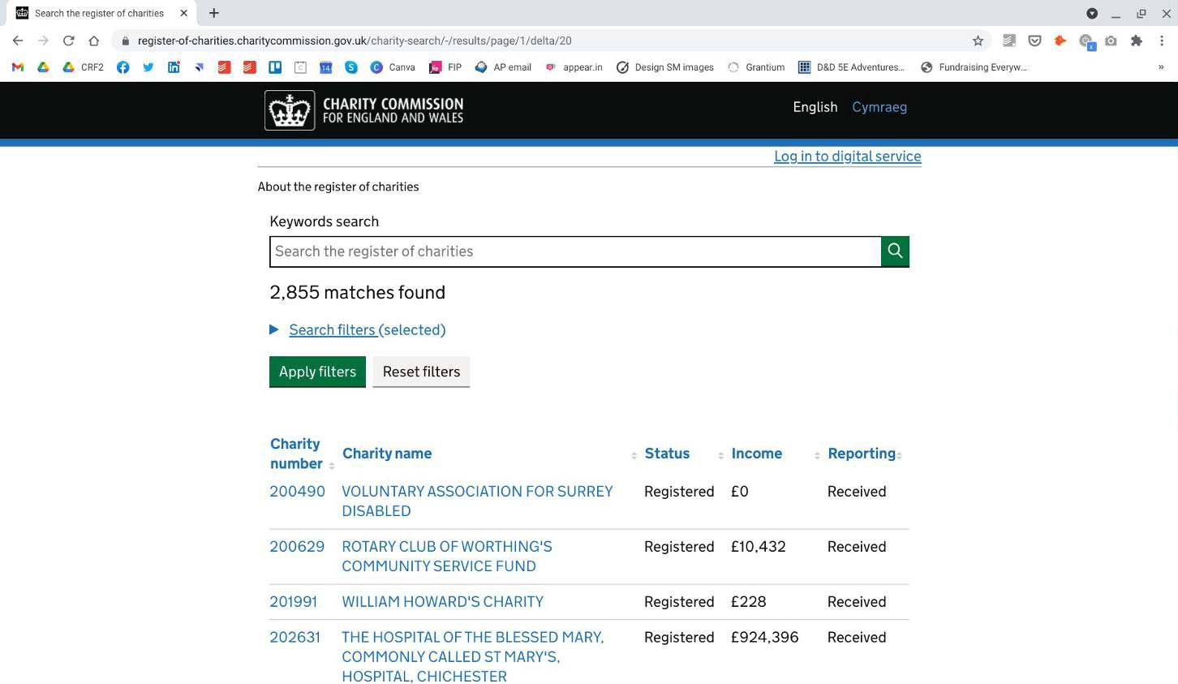
West Sussex example
Competitors websites and accounts
Export

Slide 26
Charity Details Export Headings
Charity Number
Charity Subsidiary
Charity Number
Charity Name
Charity Address
Charity Postcode
Charity Constituency
Phone
Email
Website
Last Recorded Financial Year
Last Recorded Income
Last Recorded Expenditure
Charity Status
Charity Type
How the charity helps
What the charity does
Who the charity helps
Activities
Charity Objects

Slide 27
Looking at individual charities
Not all charities giving grants have a website.
Many will be happy to get a letter, email or phone call.
They are all required to provide certain information
to the Charity Commission.
Research even if you think you know them!
Let’s look at one...

Slide 28
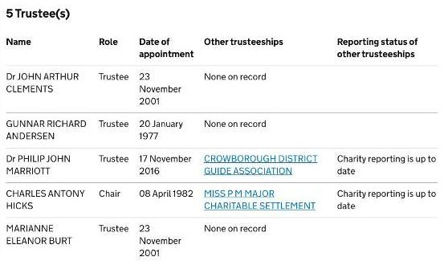
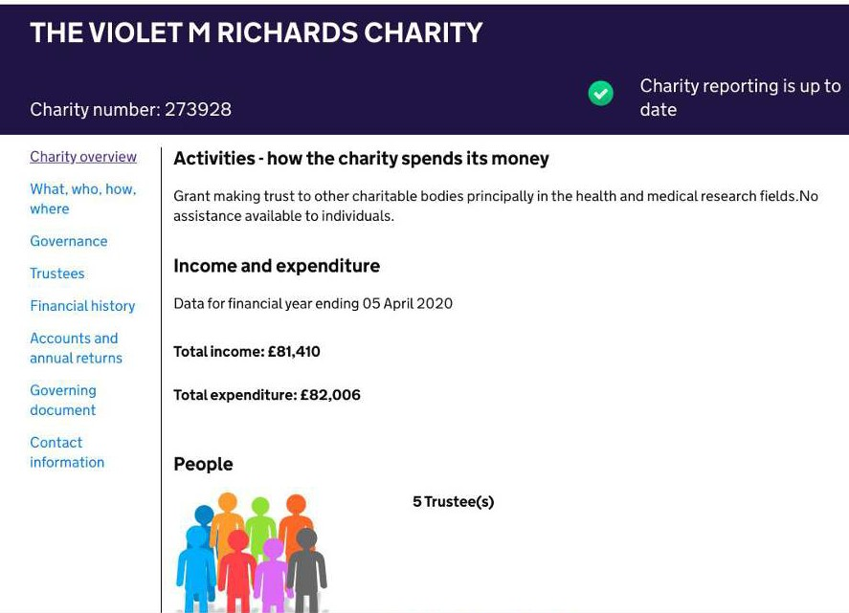
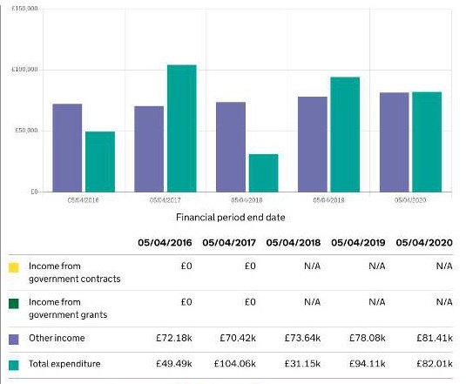
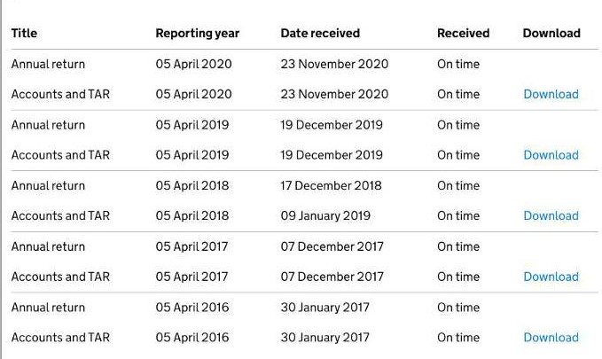
Click to download

Slide 29
What can the accounts tell you?
Objectives and Aims
Public benefit
Grant making policy
Future plans
Grants given - who, amount given, length

Slide 30
The Violet M Richards Accounts
Who the charity helps
relief of the aged, the relief of sickness and the advancement of medical education to support particularly medical research and research into geriatric problems, homes for the sick, facilities for the relief of the elderly and medical education
East Sussex/ Crowborough area, where the Founder lived.

Slide 31
The Violet M Richards Accounts
Grant giving decision making
The Trustees prefer to be proactive with charities of their own choice, rather than react to external applications. Accordingly external applications are not encouraged and to save costs are not acknowledged and only successful applicants are notified
individual trustees to nominate beneficiaries which they think are in the spirit of the Founder.

Slide 32
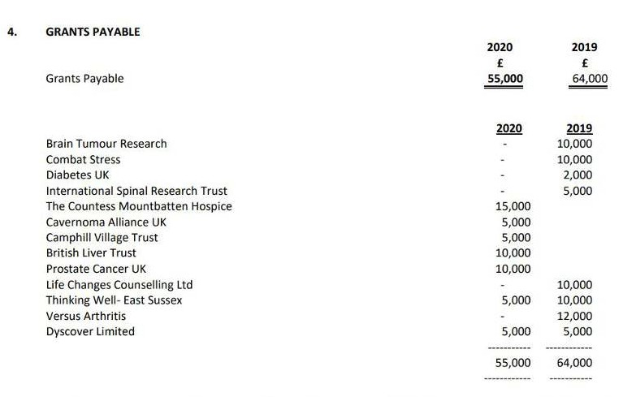
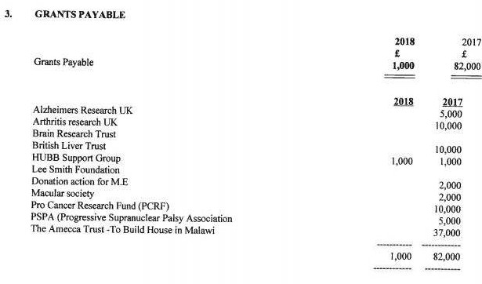
The Violet M Richards Accounts

Slide 33
Storing your research: Database

Slide 34
Storing your research: Database
Purpose
Overview of who is on your radar
Tracking and storing information
Date of action
To support applications, stewardship and evaluation
Funds you have reviewed that aren9t for you

Slide 35
Storing your research: Database
What to include
Web and Charity Commission link
Scoring system (grant size and fit)
Match to your work (RAG)
Action needed
Date of action

Slide 36
Storing your research: Database
What to include
Type of application - letter, email, application, network
Status of application - draft, submitted, result
Relationship - past funder, current funder, prospect

Slide 37
Storing your research: Database
Things to think about
Can be a simple excel document
Regularly update and check the data
Keep it simple - it is to make decisions and take action not to store all information
Don9t over complicate it!
8Chunk9 the time spent on it.

Slide 38
Be curious. Be nosy. Ask Questions!

Slide 39
Keep in touch
I will be producing free templates over the coming months so please email me
lucy@nostoneunturned.uk
@Lucy_Stone
www.nostoneunturned.uk
www.linkedin.com/in/lucy-stone-charity/

