Slide 1
Writing for Impact
Lucy Stone

Slide 2
Lucy Stone - about me!
Increase Grant, Trust and Foundation income
Develop new income streams
Improve relationships with funders
Arts & Cultural organisations
Sussex Grassroots Organisations

Slide 3
Who I've worked with

Slide 4
I am also a Trustee!

Slide 5
You
How are you?
How is your mental health?
Are you getting support?
Are you taking breaks?
How is your time management?
Are the 8nos9 hitting you harder?

Slide 6
You
You can not do your best work for your organisation if you are not ok.
You can9t write well if you are frazzled
This has always been an important question, however, post COVID-19 and cost of living crisis the world is very different.

Slide 7
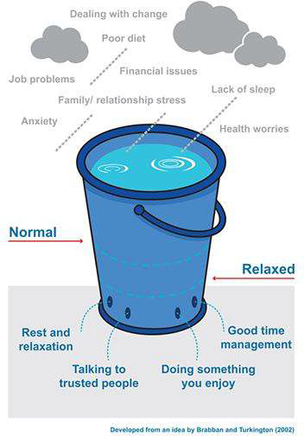
Stress Bucket

Slide 8
Writing for Impact - what do we mean?
Other titles for this session
Be less boring
Get to the point
Focus on the key information
Stop waffling
Let9s start a relationship!
Make a human connection!

Slide 9
Session Overview
Behavioural Economics
Case for Support
General Tips
Types of Writing: Applications, Free Form Applications, Letters
Useful resources

Slide 10
1. Behavioural Economics

Slide 11
Behavioural Economics
Traditional economics assumes we are all rational acting in our best interests.
BE says we we often use
short-cuts, also called heuristics (intuition), to make these choices instead of using logic. It helps avoid danger or risk, saves time, and energy but not necessarily rational.
Neuroscience
Behavioural Economics
Evolutionary Psychology
Economics

Slide 12
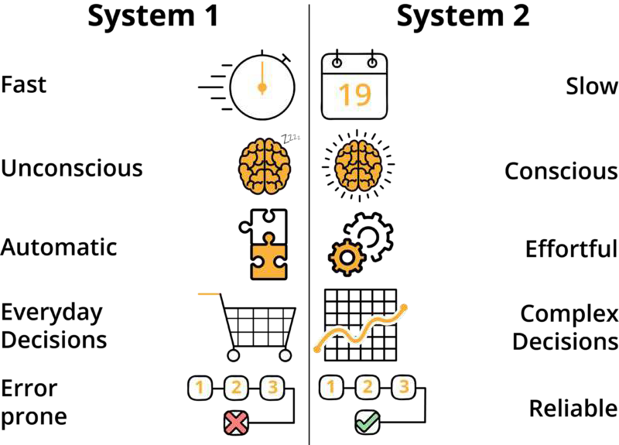
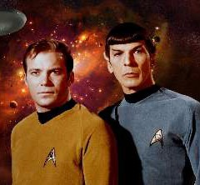
Explicit Analytical Learned Rule-based
Implicit Intuitive Instinctive Emotional
How we think
How we think we think

Slide 13
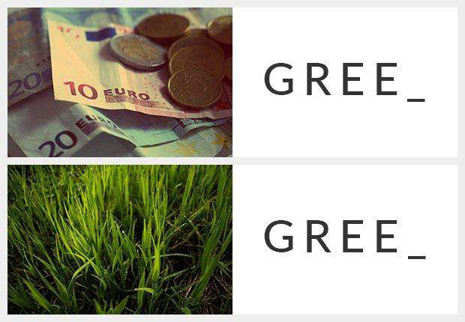
Priming & Anchoring

Slide 14
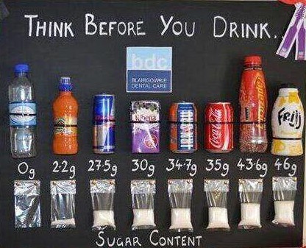
Nudge

Slide 15
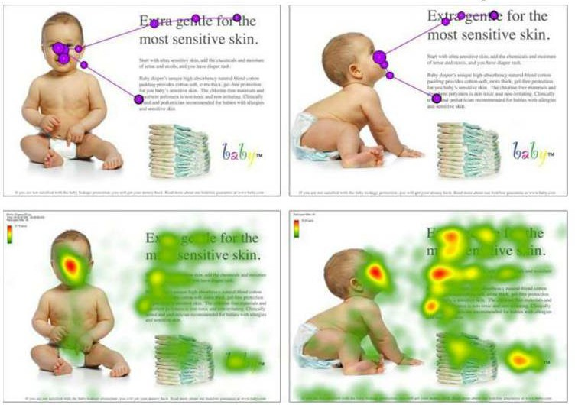
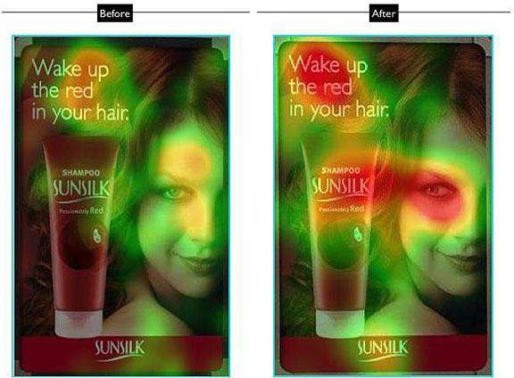
Faces
We look at faces
We look where the eyes are looking

Slide 16
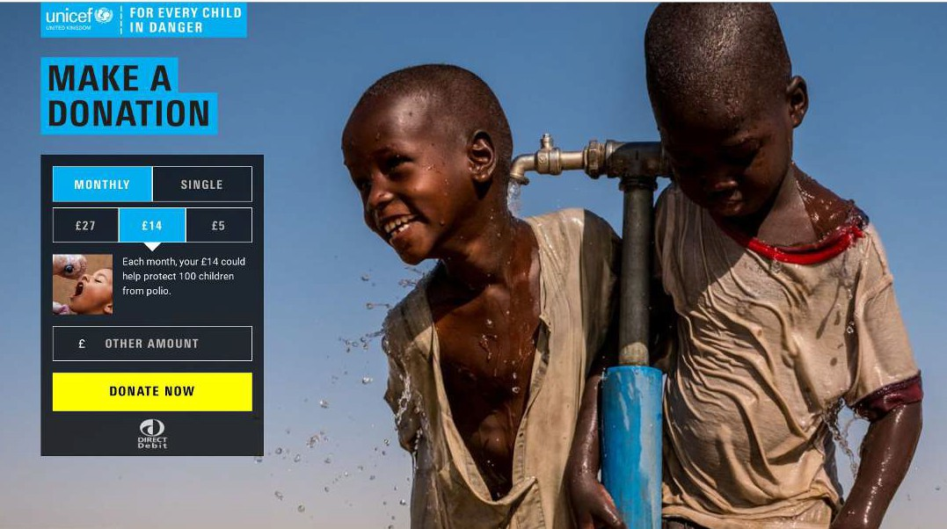
Look at the donation ladder
Look at where the child is looking

Slide 17
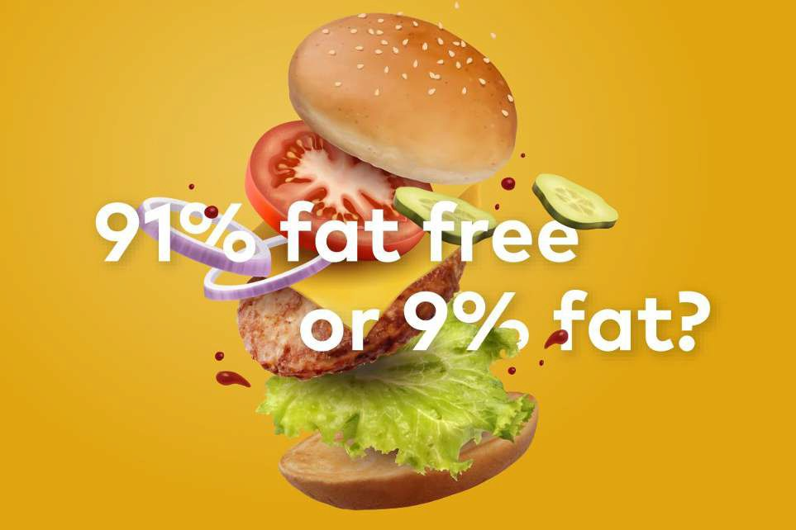
Framing
And… Mirror Neurons

Slide 18
Which doctor would you choose?
With treatment you have an 80% chance of survival
This treatment has a 20% chance that you will die
Same facts, different message

Slide 19
Which stories work?
 | PRESENT | FUTURE
POSITIVE | Opportunity | Vision
NEGATIVE | Crisis | Risk
Management Centre https://www.managementcentre.co.uk/

Slide 20
BE and your writing
Is it quick and easy to understand? (System 1)
Does it help the reader think we are a safe investment? (No risk)
How can you include and increase empathy? (Mirror Neurons)
Does it shows that others support you? (Social Proof)

Slide 21
BE and your writing
Do you uses signs and signifiers the reader will understand? (Priming)
Have you made the most of you data? (Framing)
Is the decision making easy? (Heuristics)
How have you ensured movement to action? (Nudge)

Slide 22
2. Case for Support

Slide 23
What is a case for support?
Message to your supporters about why you should be supported
Tells people what you will do with their funding support/ donation
Can be for a campaign or the whole organisation
Tells your story

Slide 24
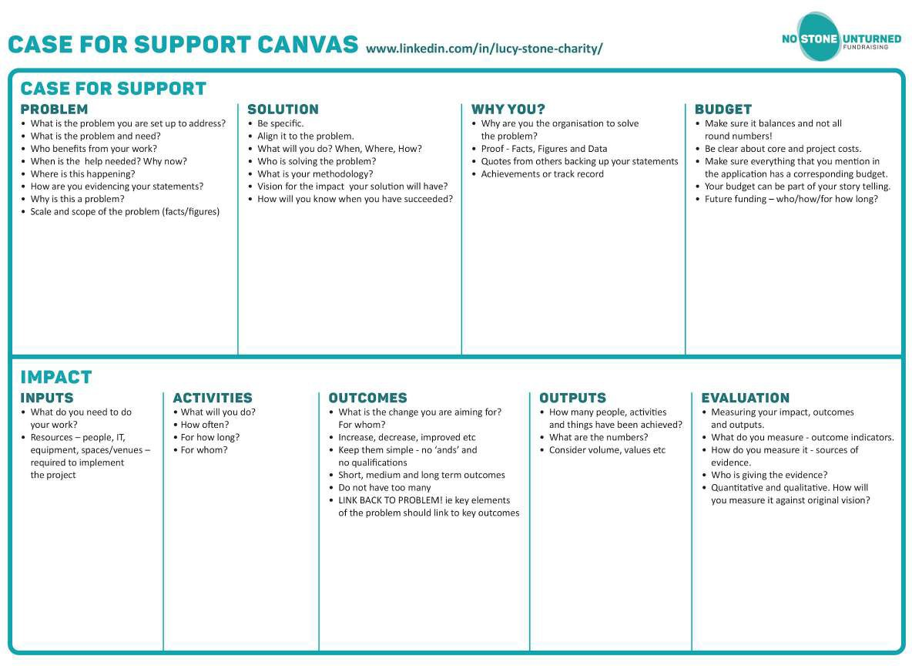

Slide 25
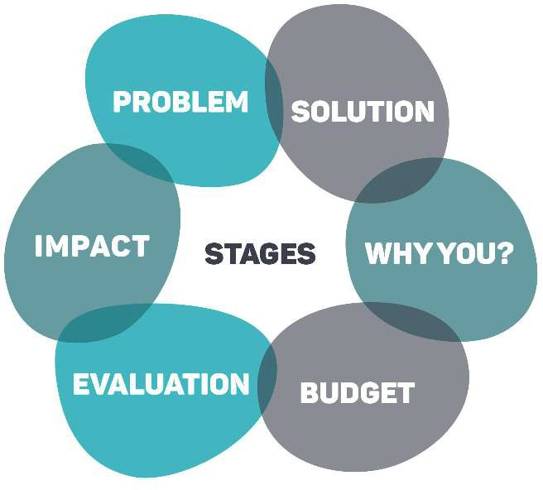
Case for Support

Slide 26
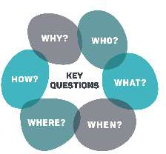
What is the problem you are set up to address?
What is the problem and need?
Who benefits from your work?
When do you need help? Why now?
Where is this happening?
How are you evidencing your statements?
Why is this a problem?
Scale and Scope - facts and figures

Slide 27
Be specific.
Align it to the problem.
What will you do? When, Where, How?
Who is solving the problem?
What is your methodology?
Vision for the impact your solution will have
How will you know when you have succeeded?

Slide 28
Why are you the organisation to solve the problem?
Proof - Facts, Figures and Data
Quotes from others backing up your statements.
Achievements or track record

Slide 29
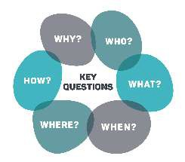
Inputs, Activities, Outcomes, Outputs
Outcomes
What is the change you are aiming for as part of your work?
Increase, decrease, improved
Keep them simple
Short, medium and long term outcomes

Slide 30
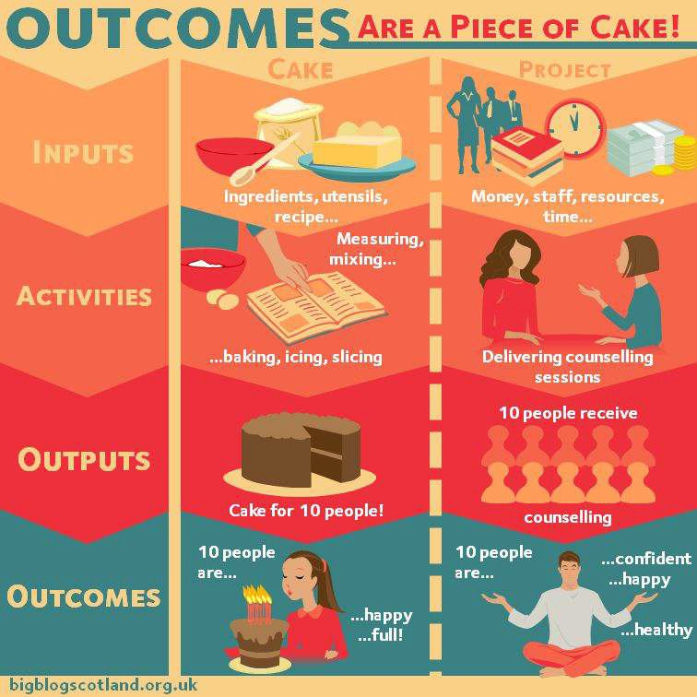
https://bigblogscotland.org.uk/2014/03/17/outcomes-are-a-piece-of-cake/

Slide 31
Measuring your outcomes and outputs.
What do you measure - outcome indicators.
How do you measure it - sources of evidence.
Who is giving the evidence?
Quantitative and qualitative.
How will you measure it against your vision?

Slide 32
Make sure it balances.
Be clear about core and project costs.
Make sure everything that you mention in the application has a corresponding budget.
Your budget can be part of your story telling.
Future funding - how/ who and for how long?

Slide 33
3. General Tips

Slide 34
General Tips - Language
Short sentences - 17 words
Active vs. Passive Voice - for example 8children love ice cream9 (active) vs. 8ice cream is loved by children9 (passive)
Plain English - Be clear - Avoid Jargon
Donor and people are the heroes
Use data
Tell Stories - write with the heart
Spelling (including names!)

Slide 35
General Tips - Layout
Headers
Bullet Points
Lists
Photos
Infographics
Bold/ Italic
Data - evidence
What do you want to draw their attention to?
Examples of this later...

Slide 36
General Tips
Keep a central documents that you use for applications up to date
Ask for feedback
Cover the first 2 paragraphs and see if you need them
Read it backwards!
Think about the reader - be kind to them!
Whatever the format - make sure you cover the main parts of the Case for Support.

Slide 37
Funders pet peeves
Copy and paste or question not answered
Budget that doesn9t balance
Missing info or attachments
8Completely unique'
Anecdotes not data
Not read the guidance
All concept no practical information - who, what, when,
where, how?

Slide 38
Let’s look at some writing examples
This is not a confession session!
We9ve all written like this at some point!
Be critical - how would you received this information?
Think about the reader!

Slide 39
Long sentences that have no punctuation are very hard to follow and sometimes you start talking about one thing but then end up talking about something else which you understand as the person who wrote the sentence but the person reading it can9t tell where one idea ends and the other starts which also means that key thoughts or points are lost.

Slide 40
Short sentences are powerful. Good punctuation is your friend to help you make important points! Bullet points are helpful because you:
highlight your main points
ensure your ideas are clear
make sure you don9t go off on tangents

Slide 41
Example
We believe that all children have the right to art and culture as in the The United Nations Convention on the Rights of the Child states in Section 31.
States Parties recognize the right of the child to education, and with a view to achieving this right progressively and on the basis of equal opportunity, they shall, States Parties shall respect and promote the right of the child to participate fully in cultural and artistic life and shall encourage the provision of appropriate and equal opportunities for cultural, artistic, recreational and leisure activity.
We deliver art workshops to help children unleash their creativity.

Slide 42
You could just say...
Children are creative. We help them unleash their creativity.

Slide 43
Example
We are a charity (no 12345) formed in 1927 called XYZ Charity. We used to support people with disabilities including learning and physical disabiliies but after a new CEO called Joe Bloggs joined the organisation in 1997 we now focus on working with autisic children. Because of our funding we only work with children under the age of
10. 8Autism is a neurodevelopmental disorder characterized by
by
difficulties with social interaction and communication, and
restricted and repetitive behavior.9 (Wikipedia). Many autisitc children have other neurodevelopmental disorders such as ADHD, DLD, IDD, GDD, NVLD or Down syndrome.

Slide 44
We are a charity (no 12345) formed in 1927 called XYZ Charity. We used to support people with disabilities including learning and physical disabiliies but after a new CEO called Joe Bloggs joined the organisation in 1997 we now focus on working with autisic children. Because of our funding we only work with children under the age of 10. 8Autism is a neurodevelopmental disorder characterized by difficulties with social interaction and communication, and by restricted and
Typo
Who cares?
Ah - that’s what you do!
Errrr - ok - what does that mean? Why that source?
repetitive
autsici
behavior.9
children
(Wikipedia). have
Many other
neurodevelopmental disorders such as ADHD, DLD, IDD, GDD, NVLD or Down
syndrome.
You’ve lost me now!

Slide 45
4. Types of Writing
Application forms
Free form application
Letter

Slide 46
Application forms
The funder has chosen the format
The summary/ intro might be the only thing that trustees read
You need to ensure you answer the questions
Use all of the tips above
Think about why they are asking this information
They will probably cover most points in the case for support

Slide 47
Dealing with word counts
& instead of 8and9
Check the, that, which
Active vs. Passive Voice - for example 8children love ice cream9 (active) vs. 8ice cream is loved by children9 (passive)
Using formatting - bullets will help with word count.
Shorter sentences

Slide 48
Free form application
When a funder asks for 2/5/10 pages
Sometimes they give you a structure - sometimes they don9t!
They will still expect to see certain content (see Case for Support below).
They may have 100s to look at
Let9s look at some layout ideas first...

Slide 49
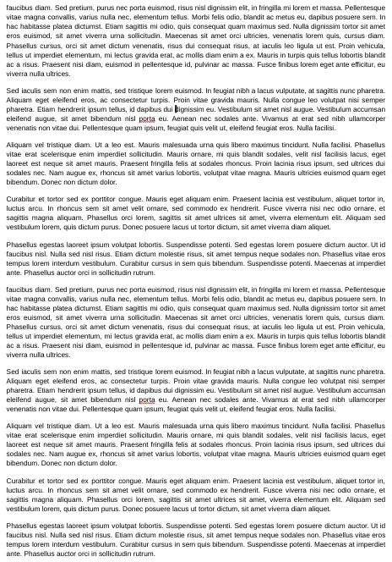
What are the issues here?
Font size
Margins pushed to the edge
Full justification
No personality
Possibility too much information
How often do you do this?
How would you feel reading this?

Slide 50
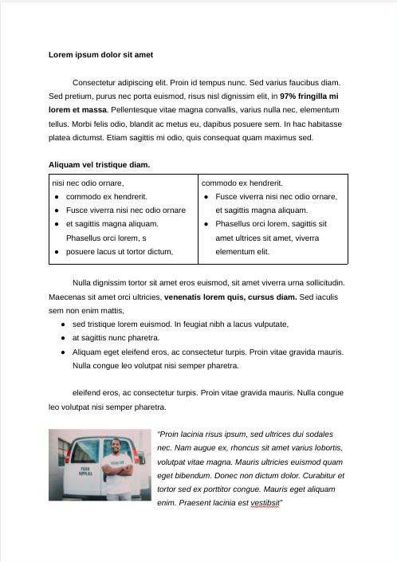
Why is this clearer?
12 point font - DDA compliant
Normal Margins
Left aligned text
Font styles - bold and italics
Bullet points
Box
Photo
Using the format to draw their attention to the important points - even if they skim it they will have a good sense of what you do!

Slide 51
Which would you prefer if you had 100 to look at?

Slide 52
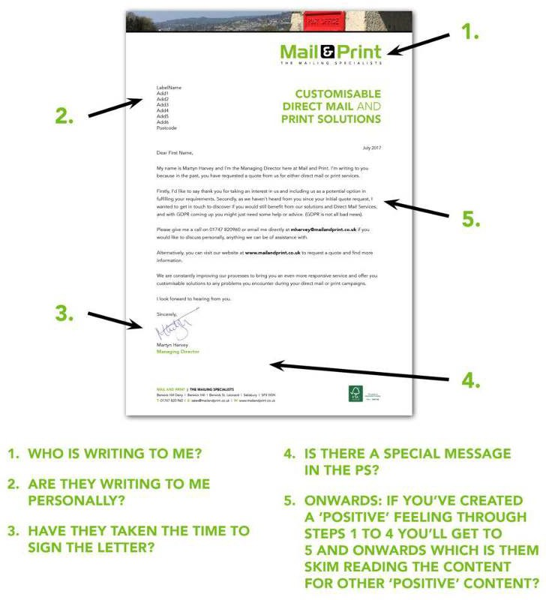
Letters - The reading curve

Slide 53
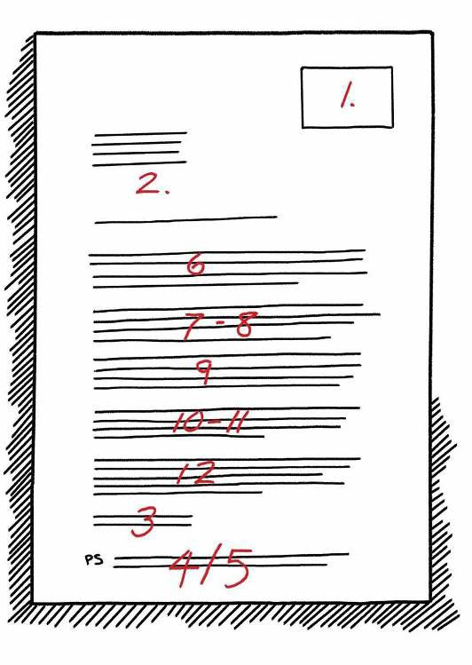
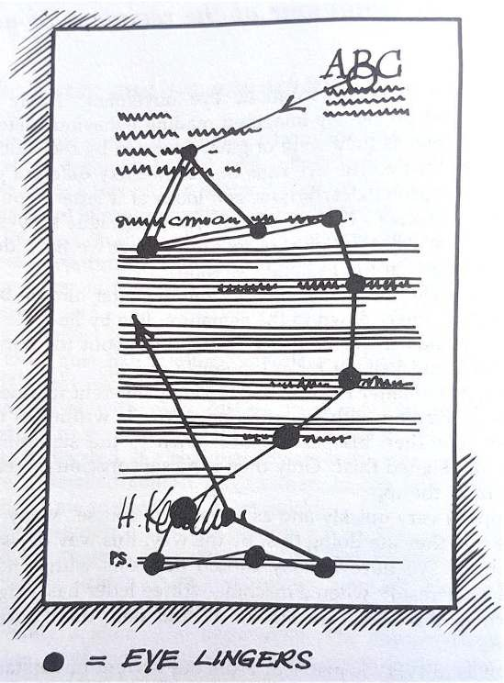

Slide 54
5. Useful resources

Slide 55
Useful resources - Behavioural Economics
Change for Good - Using Behavioural Economics for a Better World by Bernard Ross and Omar Mahmoud HERE
Decision Science - case studies, events and research HERE
Mind Space: Helping Supporters Choose – putting the science into cultural fundraising HERE
Nudgestock - https://nudgestock.co.uk/

Slide 56
Useful resources - writing
Hemingway app http://www.hemingwayapp.com/
Powerful words https://coschedule.com/blog/emotional-headlines/

Slide 57
Useful resources - Deprivation statistics
To check if the area you work in is an area of deprivation you will want to look at the Lower Output Area (LOA). Output areas are to do with population sizes.
LOA info here - http://dclgapps.communities.gov.uk/imd/iod_index
.html#

Slide 58
Useful resources - data
Cultural Engagement - Arts Council England data https://www.artscouncil.org.uk/research-and-data/our
-research

Slide 59
The reading curve articles
What Is the Reading Curve in Direct Mail? https://bolger.com/what-is-the-reading-curve/
Who Is Dr Siegfried Vogele? https://mailandprint.co.uk/dr_siegfried_vogele/
How People Read Letters https://medium.com/@chriskfundraising/how-people-read-letters-1e cf40948738

